Slide 1
Priority Scheduling
A priority number (integer) is associated with each process
The CPU is allocated to the process with the highest priority (smallest integer ≡ highest priority).
Preemptive
nonpreemptive
SJF is a priority scheduling where priority is the predicted next CPU burst time.
Problem
Starvation – low priority processes may never execute.
Solution
Aging – as time progresses increase (or redefine) the priority of process.

Slide 2
Q1. Using non preemptive priority scheduling technique compute the starting time of process P3 and P4; finishing time of P2 and P5; waiting time of process P3 and turn around time of process P5 for following batch of jobs
Process | Burst Time (ns) | Priority
P1 | 3 | 9
P2 | 5 | 3
P3 | 4 | 0
P4 | 8 | 8
P5 | 6 | 2

Slide 3
P1
P2
P3
P4
P5
P3
P5
P2
P4
P1
0
4
10
15
23
26
Starting Time of P1 = 23
P2= 10
P3 = 0
P4 = 15
P5 = 4
Finishing Time of P1 = 26
P2= 15
P3 = 4
P4 = 23
P5 = 10
Waiting Time of P1 = 23
P2= 10
P3 = 0
P4 = 15
P5 = 4
Turn Around Time of P1 = 26
P2= 15
P3 = 4
P4 = 23
P5 = 10

Slide 4
Q2. Using Preemptive priority scheduling technique compute the AWT and ATT for following batch of jobs
Process | Burst Time (ns) | Priority | Arrival Time
P1 | 4 | 3 | 3
P2 | 3 | 8 | 0
P3 | 5 | 0 | 4
P4 | 8 | 4 | 1
P5 | 2 | 2 | 2
P6 | 6 | 5 | 5

Slide 5
P2
P4
P5
P1
P3
P6
P2
P4
P5
P5
P3
P3
P3
P1
P4
P6
P2
0 1 2 3 4 5 6 9 13 20 26 28
Waiting Time of P1 = 6 (Finishing time-(arrival time + burst time))
P2 = 25
P3 = 0
P4 = 11
P5 = 0
P6 = 15
AWT = 57/6 = 9.5 ns
Turn Around Time of P1 = 10 (waiting time + burst time) or
(Finishing- Arrival)
P2 = 28
P3 = 5
P4 = 19
P5 = 2
P6 = 21
AWT = 85/6 = 14.16 ns

Slide 6
Round Robin (RR)
Each process gets a small unit of CPU time (time quantum), usually 10-100 milliseconds. After this time has elapsed, the process is preempted and added to the end of the ready queue.
If there are n processes in the ready queue and the time quantum is q, then no process waits more than (n-1)q time units.
Performance
q large ⇒ FIFO
q small ⇒ q must be large with respect to context switch, otherwise overhead is too high.

Slide 7
Example: RR with Time Quantum = 20
Process Burst Time
P₁ 53
P₂ 17
P₃ 68
P₄ 24
The Gantt chart is:
P₁
P₂
P₃
P₄
P₁
P₃
P₄
P₁
P₃
P₃
0
20
37
57
77
97
117
121
134
154
162

Slide 8
Process | Burst Time (ms)
P1 | 3
P2 | 5
P3 | 4
P4 | 2
P5 | 1
P6 | 6
Calculate following:
1. Waiting time of P3 and P5
2. Turn Around Time of P2 and P4
3. No. of context switching excluding first and last one
4. AWT and ATT
1
3
1
2
0
Time quantum is 2 ms.
0
4
2
P1
P2
P3
P4
P5
P6
P1
P2
P3
P4
P5
P6
P1
P2
P3
P6
P2
P6
2
4
6
8
9
11
12
14
16
18
19
21
0

Slide 9
Waiting Time of P1 = 9
P2 = 14
P3 = 12
P4 = 6
P5 = 8
P6 = 15
AWT = 64/6 =10.66 ms
Turn Around Time of P1 = 12
P2 = 19
P3 = 16
P4 = 8
P5 = 9
P6 = 21
ATT = 85/6 =14.16 ms
Total number of context switching = 13
Excluding first and last = 11
Typically, higher average turnaround than SJF, but better response.

Slide 10
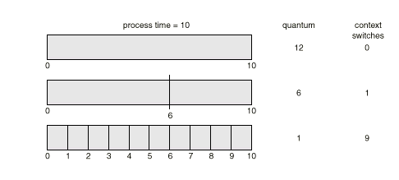
How a Smaller Time Quantum Increases Context Switches

Slide 11
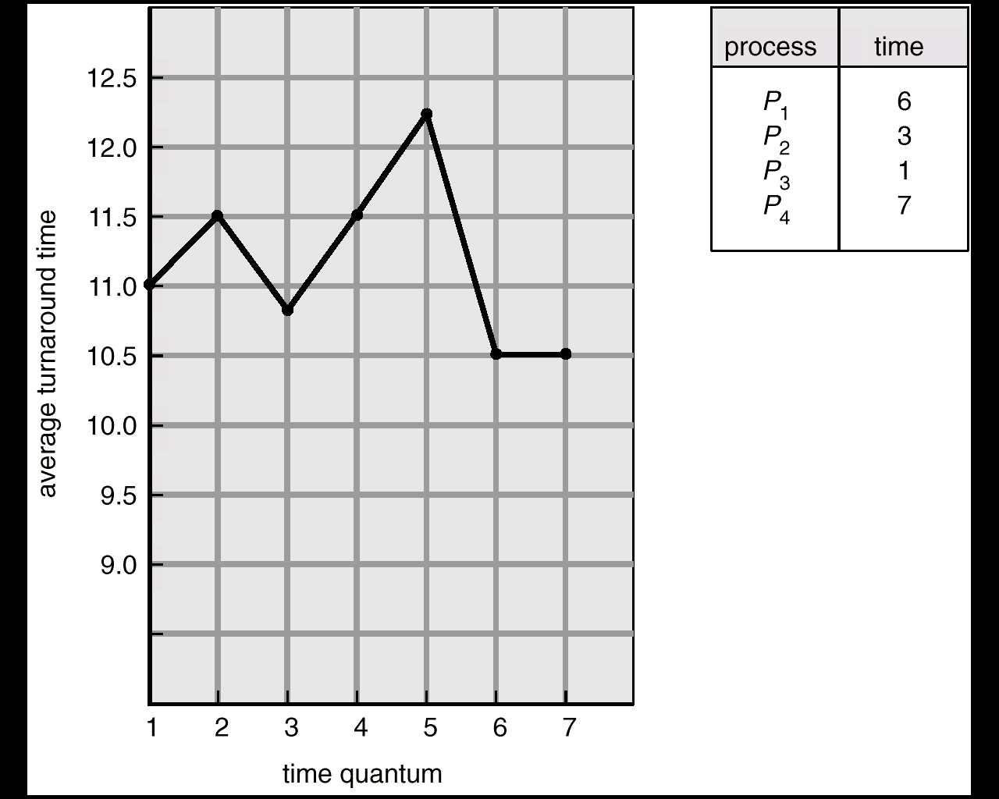
Turnaround Time Varies With The Time Quantum

Slide 12
Topics for Self-Study

Slide 13
Multilevel Queue
Ready queue is partitioned into separate queues: foreground (interactive) background (batch)
Each queue has its own scheduling algorithm, foreground – RR background – FCFS
Scheduling must be done between the queues.
Fixed priority scheduling; i.e., serve all from foreground then from background. Possibility of starvation.
Time slice – each queue gets a certain amount of CPU time which it can schedule amongst its processes; i.e., 80% to foreground in RR
20% to background in FCFS

Slide 14
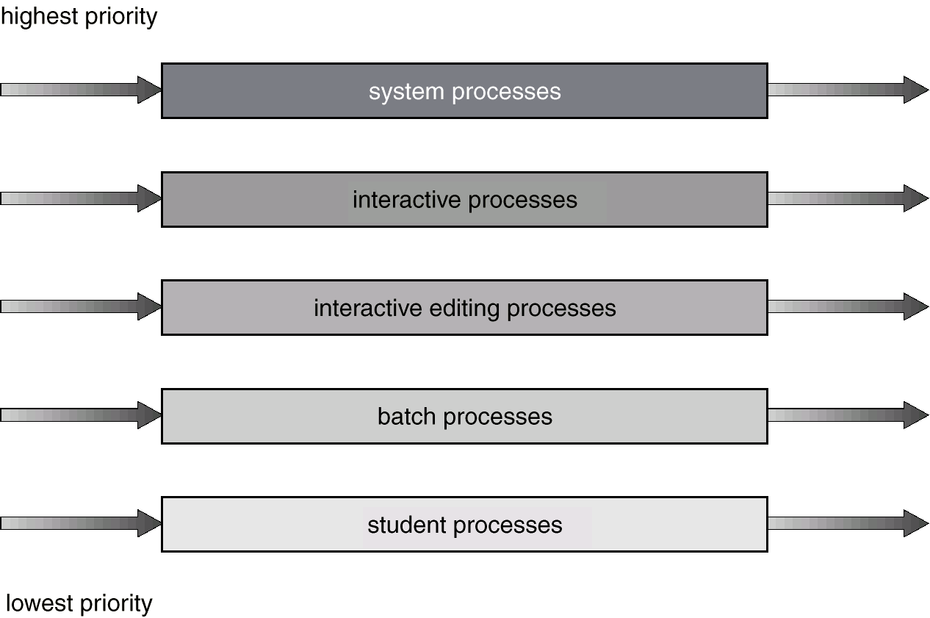
Multilevel Queue Scheduling

Slide 15
Multilevel Feedback Queue
A process can move between the various queues; aging can be implemented this way.
Multilevel-feedback-queue scheduler defined by the following parameters:
number of queues
scheduling algorithms for each queue
method used to determine when to upgrade a process
method used to determine when to demote a process
method used to determine which queue a process will enter when that process needs service

Slide 16
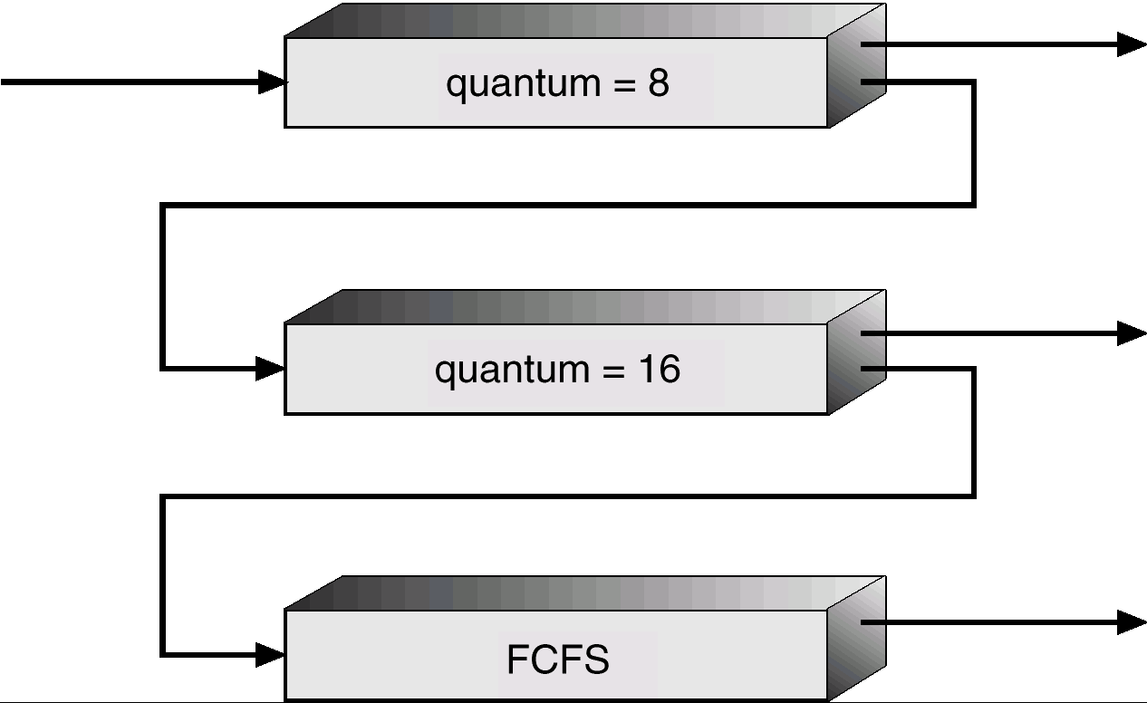
Multilevel Feedback Queues

Slide 17
Example of Multilevel Feedback Queue
Three queues:
Q₀ – time quantum 8 milliseconds
Q₁ – time quantum 16 milliseconds
Q₂ – FCFS
Scheduling
A new job enters queue Q₀ which is served FCFS. When it gains CPU, job receives 8 milliseconds. If it does not finish in 8 milliseconds, job is moved to queue Q₁.
At Q₁ job is again served FCFS and receives 16 additional milliseconds. If it still does not complete, it is preempted and moved to queue Q₂.

